Slide 1
A Roadmap to Ohio’s Electricity Future
Energy Policy Roundtable November 2018
Notes:
Intro

Slide 2
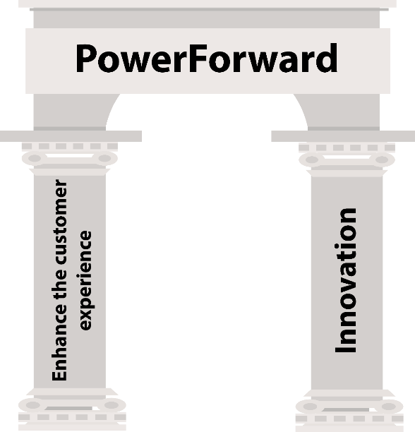
Notes:
PowerForward was built upon two pillars: Innovation and an Enhanced Customer Experience

Slide 3
A Glimpse at the Future
April 2017
Exploring Technologies
July 2017
Ratemaking and Regulation
March 2018

Slide 4
127 speakers provided approximately 100 hours of education.
Notes:
PROCESS:
In sum total, we had 127 speakers provide approximately 100 hours of education to the Commission and Staff during these three phases
We are grateful to our speakers, all of whom influenced, in one way or another, the Roadmap.

Slide 5
We’ve created a deep knowledge base through PowerForward.
Notes:
PROCESS:
How did we create this endeavor?
PowerForward consisted of three phases, all uniquely tailored to allow for the Commission to have a very thorough yet linear discussion about grid modernization
Phase I, A Glimpse of the Future, took place in April of 2017 and it presented the business case for advancing grid modernization in the State
Phase II, Exploring Technologies, took place in July of 2017, and in this phase the Commission conducted a deep dive into the engineering and architecture of the grid
Phase III, Ratemaking and Regulation, took place over a two week timeframe in March of 2018, and it explored topics that the Commission will have to grapple with when reviewing utility applications for grid investment like ratemaking, rate design, markets and cybersecurity

Slide 6
The market may change, but our principles and objectives can be relied on.
Notes:
After all of this education, the Commission believed it was important to articulate certain foundational principles and objectives for the modern grid
Innovation is dynamic and constantly evolving, but these principles and objectives can be relied upon by policymakers and stakeholders going forward always

Slide 7
Principles
Do No Harm
Provide Net Value to Customers
Create an Environment that Fosters Innovation
Enhance the Experience for All
Notes:
The four principles articulated in this Roadmap are:
Do No Harm
Provide Net Value to Customers
Create an Environment that Fosters Innovation, and
Enhance the Experience for All

Slide 8
Objectives
A Strong Grid
The Grid as a Platform
A Robust Marketplace
The Customer’s Way
Notes:
The four objectives, or desired outcomes from PUCO grid modernization decisions are:
A Strong Grid
The Grid as a Platform
A Robust Marketplace, and
The Customer’s Way

Slide 9
Grid as a Platform
Notes:
Let’s highlight one of these objectives, which is “The Grid as a Platform”
The Commission believes that the grid should serve as a secure open access platform – firm in concept and as uniform across our utilities as possible – that allows for varied and constantly evolving applications to seamlessly interface with the grid
The distribution system platform, we believe, consists of the following elements:
The cyber-physical grid
Distribution system planning
Distribution system operations, and
Distribution system markets

Slide 10
Operations
Markets
Planning
Grid Architecture

Slide 11
PowerForward in Action
FirstEnergy (FE) Case Study
History
Feb. 2016 FE files $5 billion grid mod application
Oct. 2016 PUCO announces PowerForward grid mod endeavor
Dec. 2017 FE pares down filing in early 2018, requesting $500 million to prepare grid for PowerForward endeavors
Aug. 2018 PUCO releases PowerForward Road Map
Nov. 2018 PUCO Staff, FE and other parties enter into Stipulation allowing for FE grid architecture deployment as articulated in PowerForward

Slide 12
PowerForward in Action
FirstEnergy (FE) Case Study
Customer Benefits
Grid Architecture
700, 000 AMI meters
Meter Data Management System
Distribution Automation – installed on 200 circuits
Integrated Volt-VAR Control – installed on 200 circuits
Taxes
$900 million to be returned to customers.

Slide 13
Next steps
PowerForward Collaborative
Planning Working Group
Data Working Group
Notes:
There is also a description of, and tasks assigned to the over-arching PowerForward Collaborative as well as the two spinoff working groups - the Planning Working Group and the Data Working Group

Slide 14
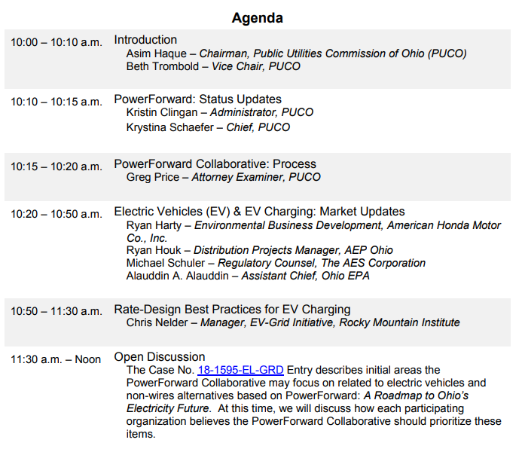
Collaborative
Dec. 6, 2018
Notes:
There is also a description of, and tasks assigned to the over-arching PowerForward Collaborative as well as the two spinoff working groups - the Planning Working Group and the Data Working Group

Slide 15
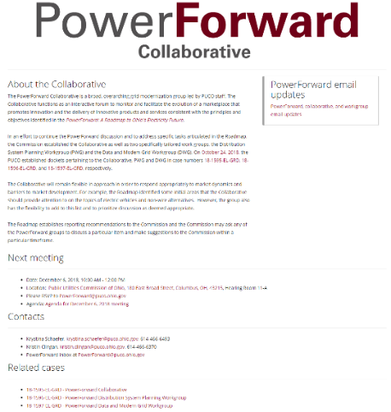
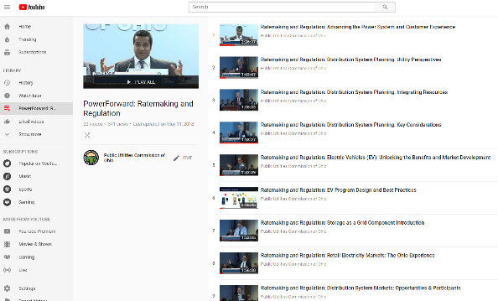
Stay in touch

Slide 16
A Roadmap to Ohio’s Electricity Future

